Slide 1
Exploring Suburbs of Melbourne
Nabeel Khan
06/09/2019

Slide 2
Motivation
In big cities, it is important to find a reasonable suburb to live. The reasonable suburb is the one
with minimal or zero crime rate, and
is not very far from the main city center
People especially immigrants have no access to this information
And, property agents lack this knowledge or hide it to make sales

Slide 3
Project Goal
In this project, I report
Top 5 suburbs of Melbourne to live
Best suburb with the least crime rate
Five common venues for the suburbs (for more insights)
Worse 5 suburbs of Melbourne
So people can avoid those areas
Geospatial crime distribution
Goal is to give insights to immigrants so they can choose a suburb to settle down in Melbourne

Slide 4
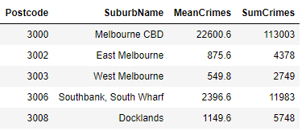
Crime Data Acquisition
I downloaded the crime stats from the website
The crime stats have only postal codes and lack suburb information
I used a table from Wikipedia page to extract the suburbs information
I merged the suburbs information with the crime stats
I also performed some data cleaning (some records were duplicated)
The final data looks like this
Note: Mean and Sum Crimes are computed for 2011-2015 years

Slide 5
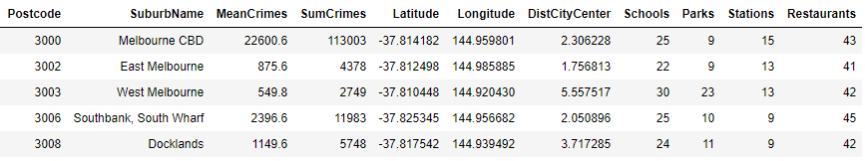
Venues Information
For any suburb, it is important to know the nearby important venues, such as schools, or beaches.
In this project, I have focused on the following important near by venues for each suburb
Schools
Parks
Restaurants
Train Stations
The reason of selecting these venues (features) is that these venues play an important part in daily life activities
I used a radius of 3 km to search the number of these venues for each suburb
I also computed the distance of each suburb from the Melbourne city center. Data looks like

Slide 6
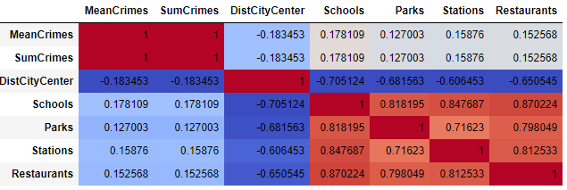
Analysis -Correlation
The correlation map does not indicate relationship of crimes with any features

Slide 7
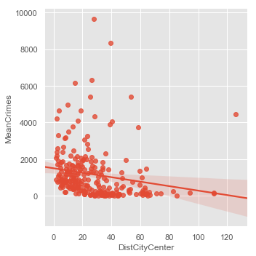
Analysis –Regression Plot
The regression plots indicate that crimes decrease as we move away from the city center

Slide 8
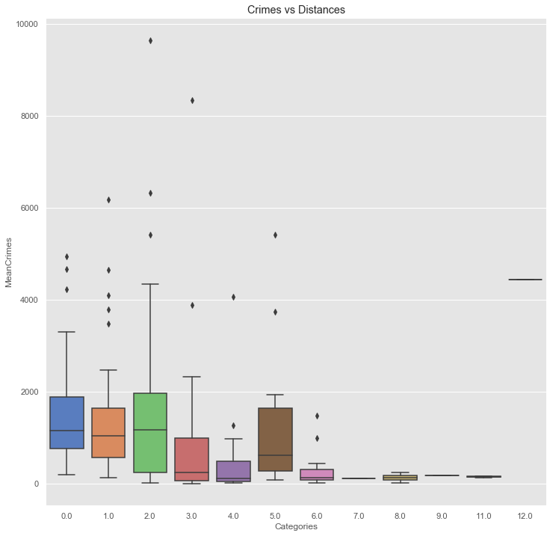
Analysis – Box plot
For a thorough analysis, I decided to use the box plot
I performed binning i.e., I grouped the distance from city center into bins or categories
Such as 1st bin covers 0-10 km, 2nd bin covers 10-20 km and so on
We can see that crimes tend to decrease as we move away from city center

Slide 9
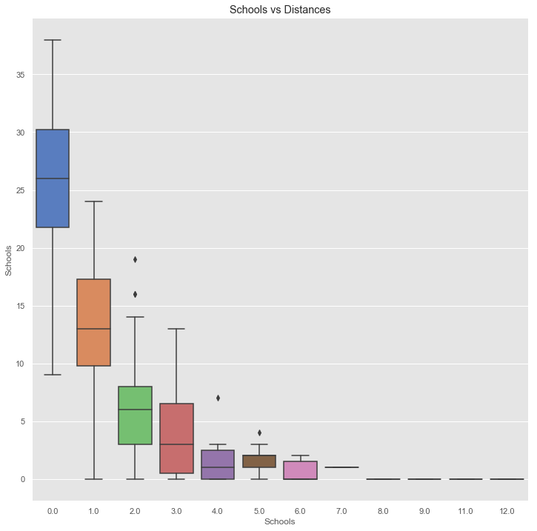
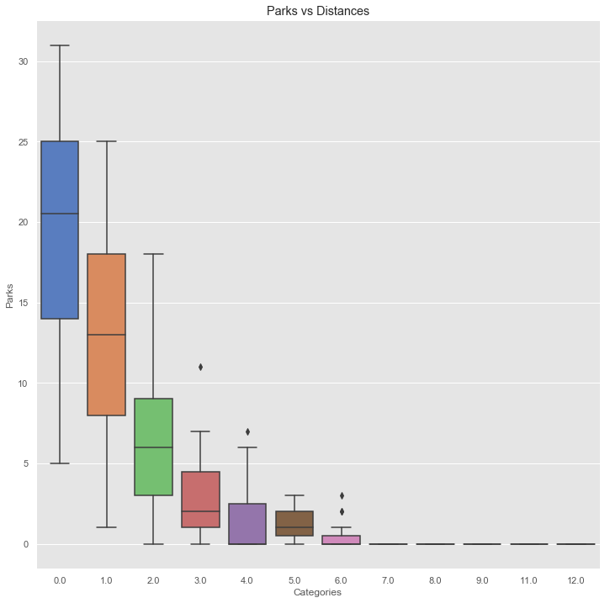
Analysis – Box plot (A)
The frequency of near by venues also decrease as we move away from the city center
Similar pattern observed for all venues
In other words, you need to drive more to go to venues if you live far away from city center
Please see the bar plots in the next slide for validation

Slide 10
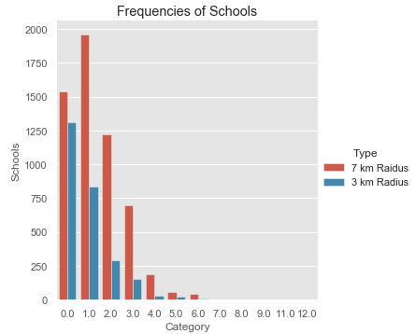
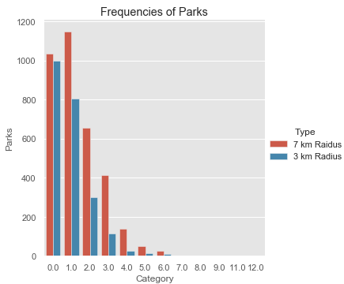
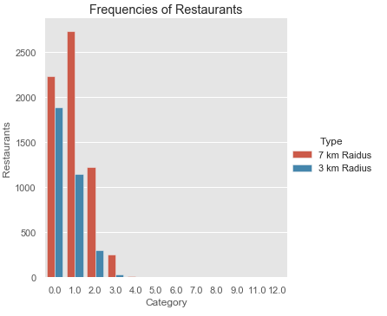
Analysis – Bar Plot
I increased the search radius from 3 to 7 km and then calculated the frequencies of venues for each suburb
We can clearly see that frequencies of venues increase (compared to 3 km) as expected
In other words, someone has to travel a bit to reach to the venues

Slide 11
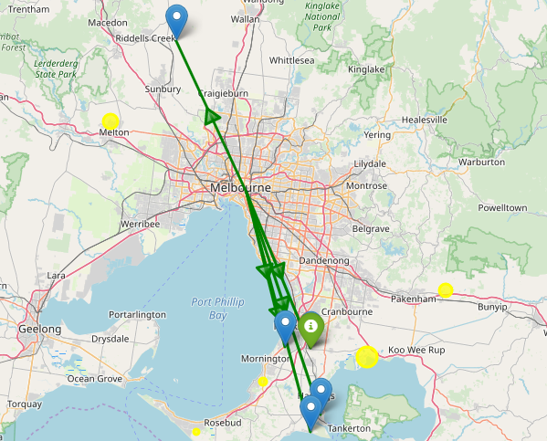
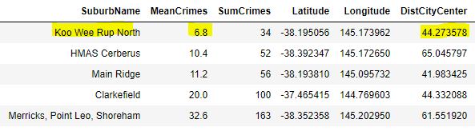
Results – Best Suburbs
Top 5 suburbs with the least crime rates
The best suburb is highlighted in yellow colour

Slide 12
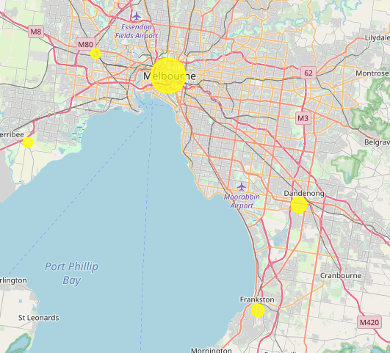
Results – Worse Suburbs
Worse 5 suburbs with the highest crime rates
The worse suburbs are highlighted in yellow colour
The city center is found to be one with the highest crime rates

Slide 13
Conclusion
Avoid living in the city center due to very high crime rates.
This may be true for all major cities in the world
Try to live a bit away from the city center, such as 30 -70 km away from the city center
Because the crime rates are lower than the city center
The only drawback of living far away from the city center is that
Some commute will be required to reach to the venues

Slide 14
Limitations
The focus of the project is kept to 4 venues
Extend the focus to more venues in the future, such as grocery store, or beaches
This project does not give any consideration to the housing prices
Something to do in the future by linking crimes with housing prices
The crime stats range from 2011-2016
Better to find another source of data with the latest stats

